Slide 1
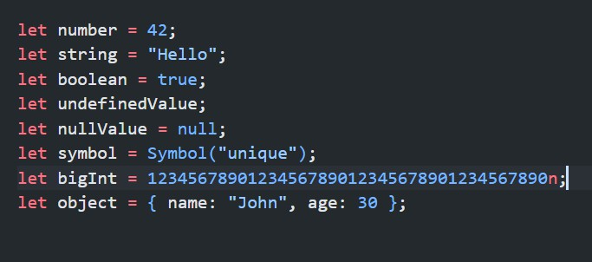
1. What are the data types in JavaScript?
JavaScript has eight data types, divided into two categories: primitive and non-primitive (object).

Slide 2
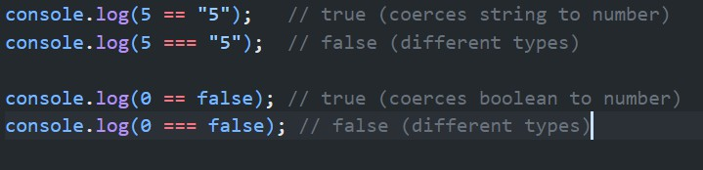
2. What is the difference between == and ===?
The == (equality) and === (strict equality) operators are used for comparison in JavaScript.
== (Equality): Performs type coercion before comparison and then it compares values after converting them to a common type.
=== (Strict Equality): Does not perform type coercion and it compares both value and type

Slide 3
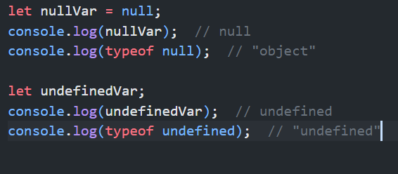
3. What is the difference between null and undefined?
Null and undefined are both used to represent the absence of a value.
Null: Must be explicitly assigned. Typeof null returns "object" (this is a known JavaScript bug)
Undefined: Represents a variable that has been declared but not assigned a value .Typeof undefined returns "undefined"

Slide 4
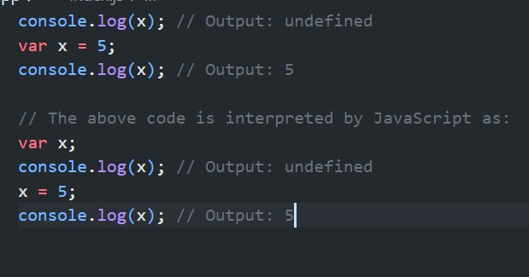
4. Explain the concept of hoisting in JavaScript.
Hoisting is a behavior in JavaScript where variable and function declarations are moved to the top of their respective scopes during the compilation phase, before the code is executed. This means that regardless of where variables and functions are declared in the code, they are treated as if they are declared at the beginning of their scope.
the declaration of x is hoisted to the top, but not its initialization. That's why the first
`console.log outputs undefined

Slide 5
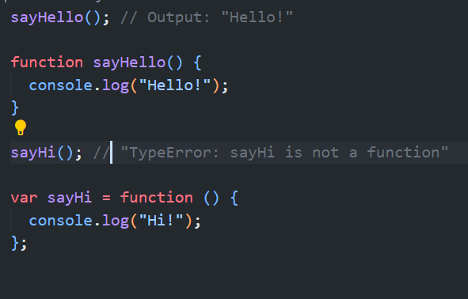
4. Explain the concept of hoisting in JavaScript.

Slide 6
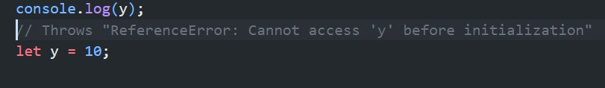
4. Explain the concept of hoisting in JavaScript.
let and const declarations are hoisted but not initialized. This leads to a "temporal dead zone" where accessing the variable before its declaration results in a ReferenceError

Slide 7
5. What is the difference between let, const, and var?
var: Function-scoped or globally-scoped. Can be redeclared and updated and Hoisted and initialized with undefined.
let: Block-scoped. Hoisted but not initialized (Temporal Dead Zone).
const: Block-scoped. Cannot be updated or redeclared. Hoisted but not initialized (Temporal Dead Zone)

Slide 8
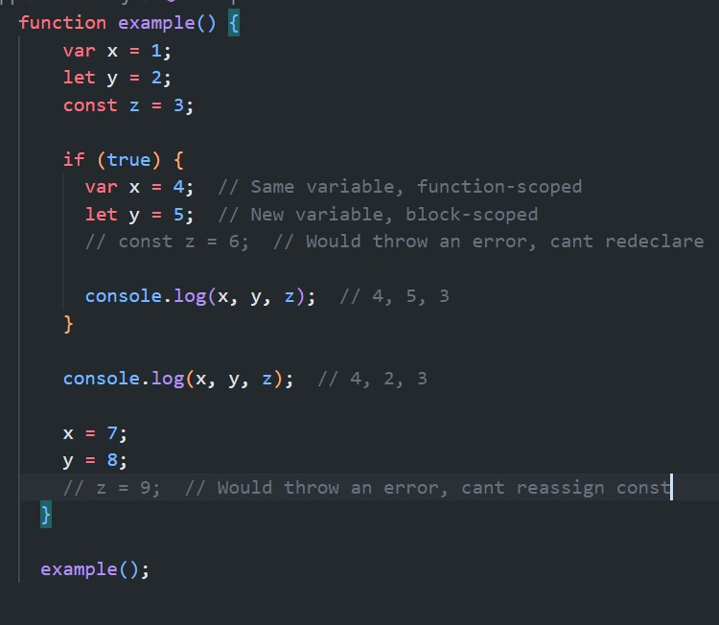

Slide 9
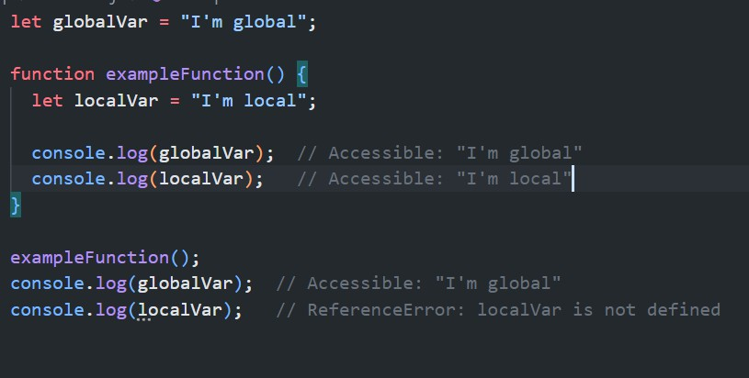
6. What is variable scope in JavaScript?
Variable scope refers to the context in which a variable is declared and can be accessed. In JavaScript, there are two main types of scope:
Global Scope: Variables declared outside any function or block
Local Scope: Variables declared inside a function or block
JavaScript uses lexical scoping, which means that inner functions have access to variables in their outer scope.

Slide 10
7. Explain the difference between global and local variables.
Global Variables: Declared outside any function or block. Accessible from anywhere in the code, including inside functions. Have global scope
Local Variables: Declared inside a function or block. Only accessible within that function or block. Have local scope

Slide 11
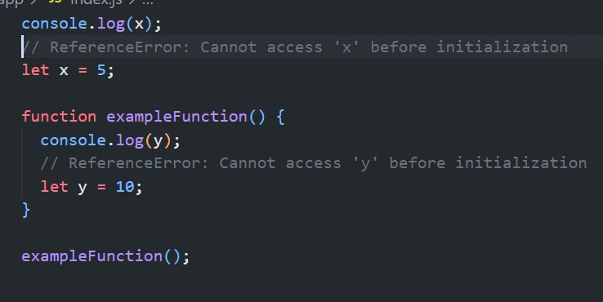
8. What is the temporal dead zone?
The Temporal Dead Zone (TDZ) is the period between entering a scope and the point where a variable is declared and initialized.
Applies to variables declared with let and const.
Helps catch errors by preventing access to variables before they're declared

Slide 12
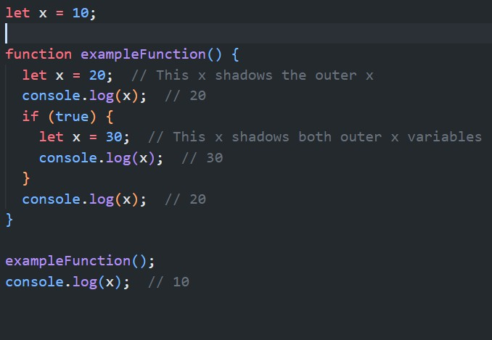
9. What is variable shadowing?
Variable shadowing occurs when a variable declared in a certain scope has the same name as a variable in an outer scope. The inner variable "shadows" the outer one, effectively hiding it.

Slide 13
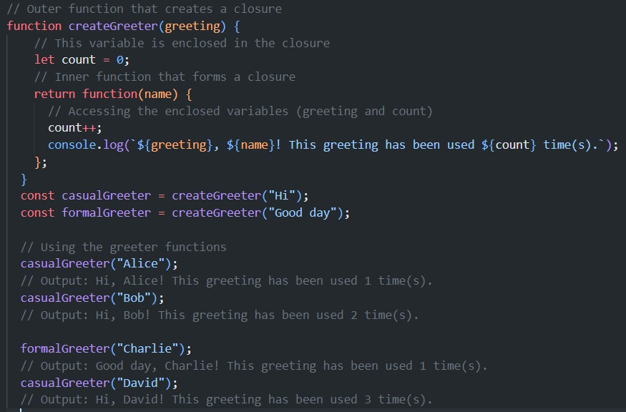
10. What is a closure in JavaScript?
A closure in JavaScript is a function that has access to variables in its outer (enclosing) lexical scope, even after the outer function has returned. Closures are created every time a function is created

Slide 14
10. What is a closure in JavaScript?
The createGreeter function returns an inner function that forms a closure.
The inner function has access to the `greeting` parameter and the `count` variable from its outer scope.
Each time we call createGreeter, it creates a new closure with its own enclosed count variable.
The returned functions (casualGreeter and formalGreeter) maintain their own separate counts, demonstrating how closures preserve state.

Slide 15
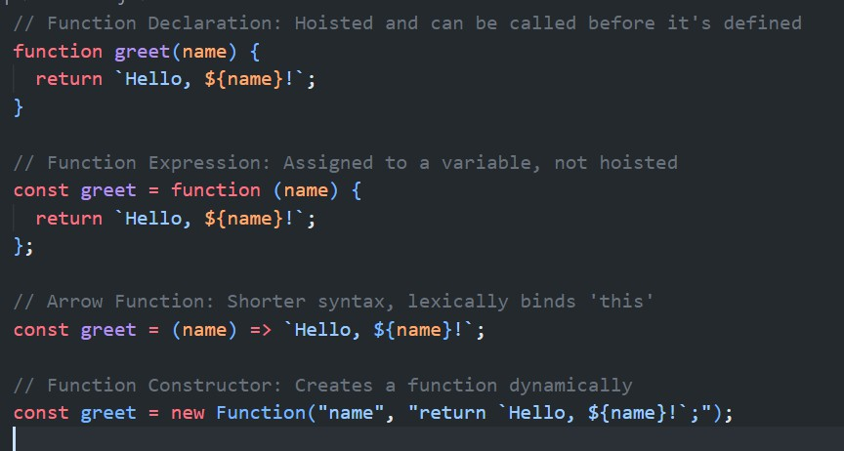
11. What are the different ways to define a function in JavaScript?

Slide 16
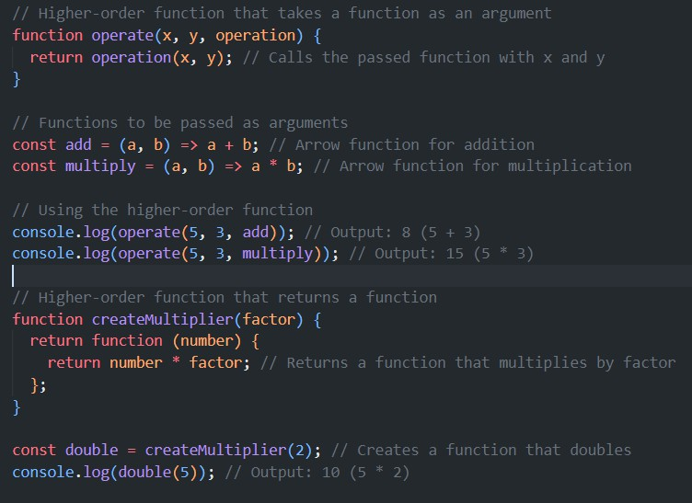
12. What is a higher-order function?
A higher-order function is a function that treats other functions as data, either by taking them as arguments or returning them.

Slide 17
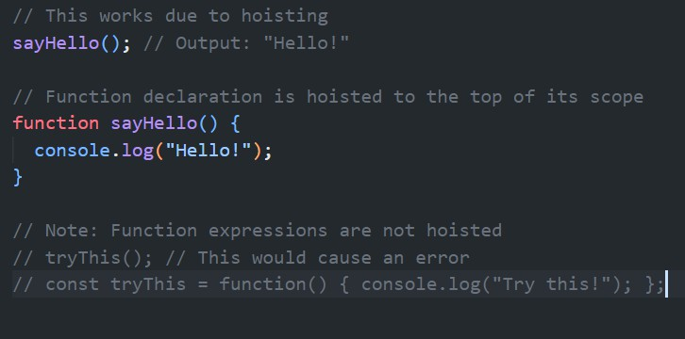
13. Explain the concept of function hoisting.
Function hoisting is JavaScript's behavior of moving function declarations to the top of their scope during the compilation phase. This allows you to call a function before it appears to be defined in the code.

Slide 18
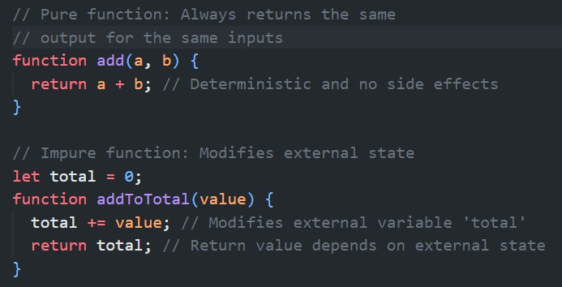
14. What is a pure function?
A pure function is a function that: Always returns the same output for the same inputs. Has no side effects (doesn't modify external state). Doesn't rely on external state. Make code more predictable and easier to test.

Slide 19
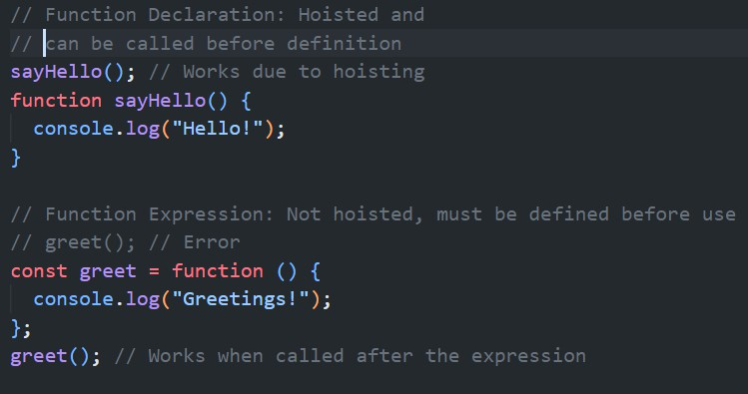
15. Difference between function declaration and function expression?
Hoisting: Function declarations are hoisted, function expressions are not. Usage: Function declarations can be called before they appear in the code, function expressions cannot.
Naming: Function declarations require a name, function expressions can be anonymous.

Slide 20
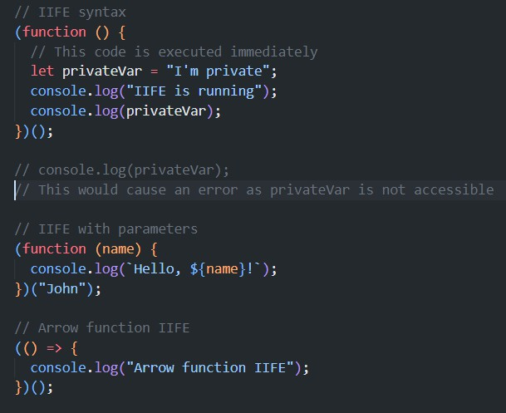
16. What is an Immediately Invoked Function Expression (IIFE)?
An IIFE is a JavaScript function that runs as soon as it is defined.

Slide 21
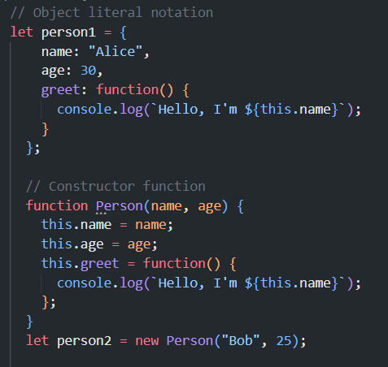
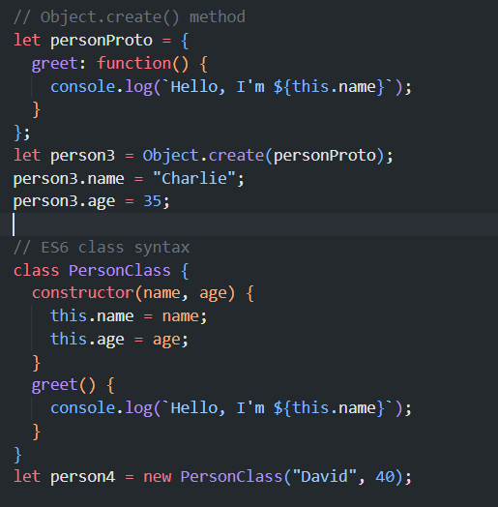
17. How do you create an object in JavaScript?

Slide 22
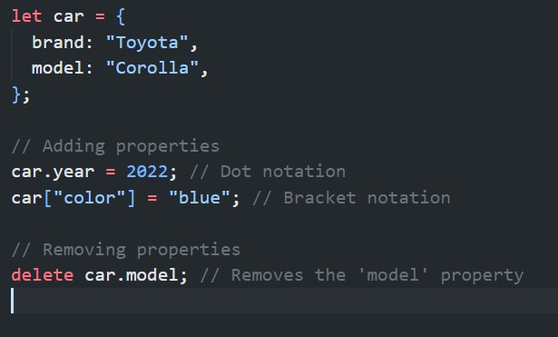
18. How do you add/remove properties to an object dynamically?

Slide 23
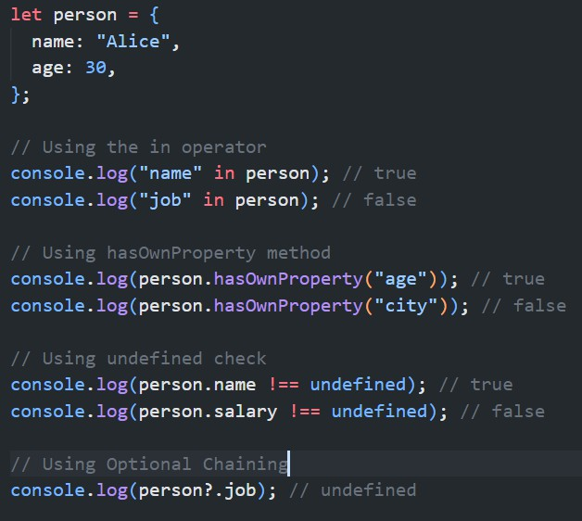
19. How do you check if a property exists in an object?

Slide 24
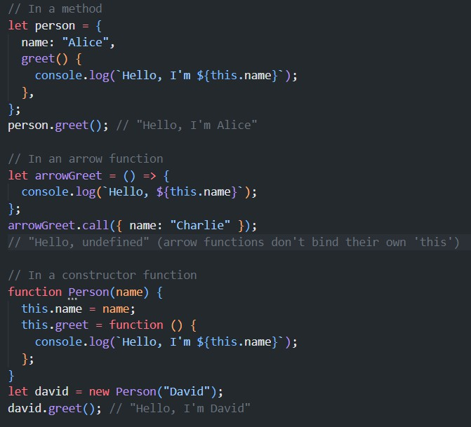
20. What is the “this” keyword in JavaScript?
The `this` keyword refers to the object that is executing the current function. Its value is determined by how a function is called.

Slide 25
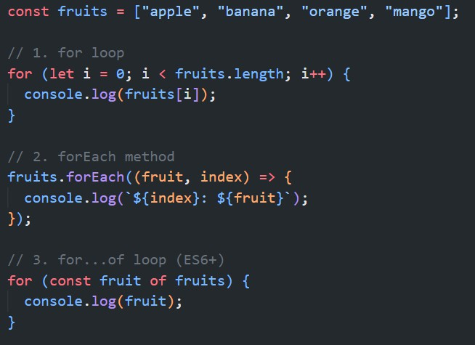
21. What are the different ways to loop through an array in JavaScript?

Slide 26
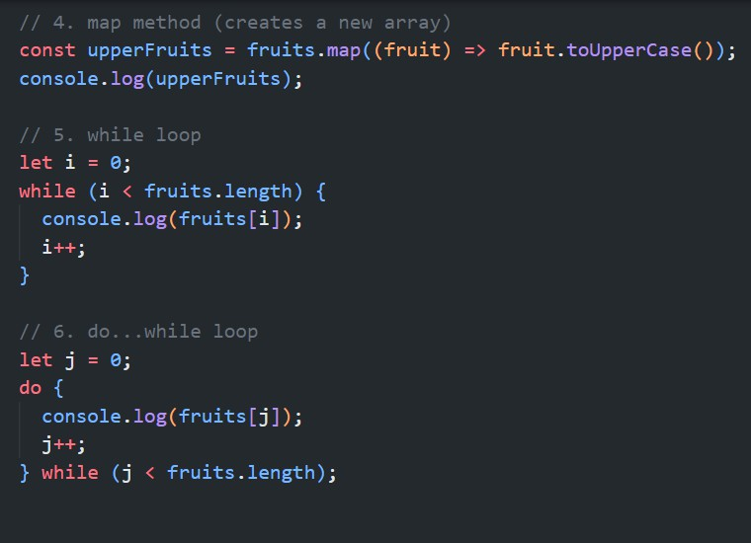
21. What are the different ways to loop through an array in JavaScript?

Slide 27
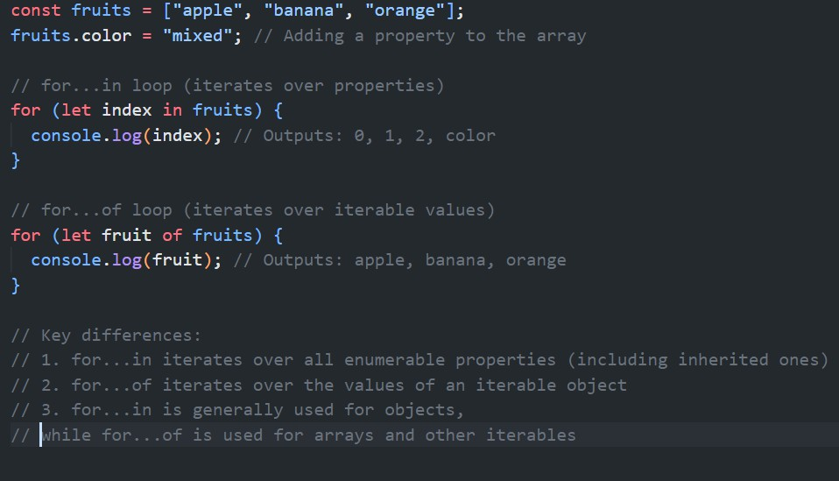
22. Explain the difference between for...in and for...of loops.

Slide 28
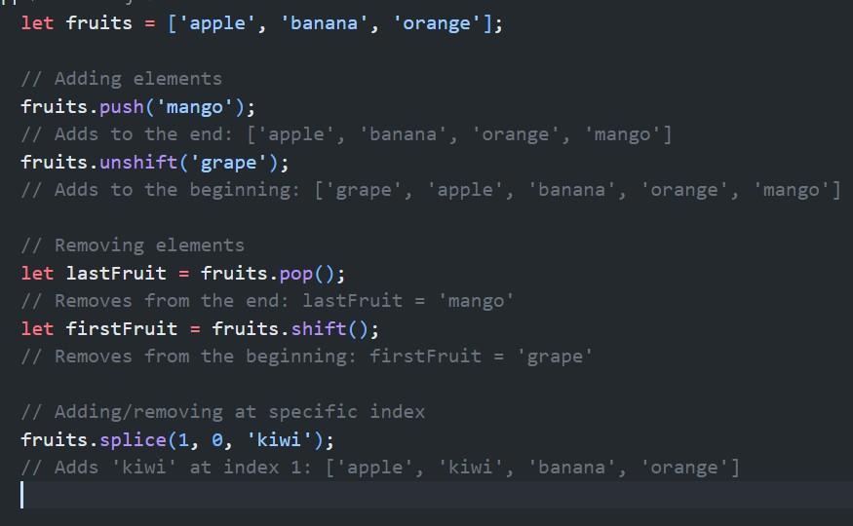
23. How do you add/remove elements from an array?

Slide 29
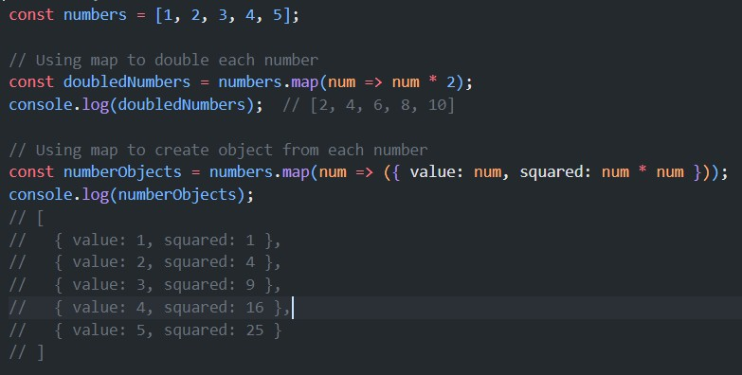
24. What is the purpose of the map() function?
The map() method creates a new array with the results of calling a provided function on every element in the array.

Slide 30
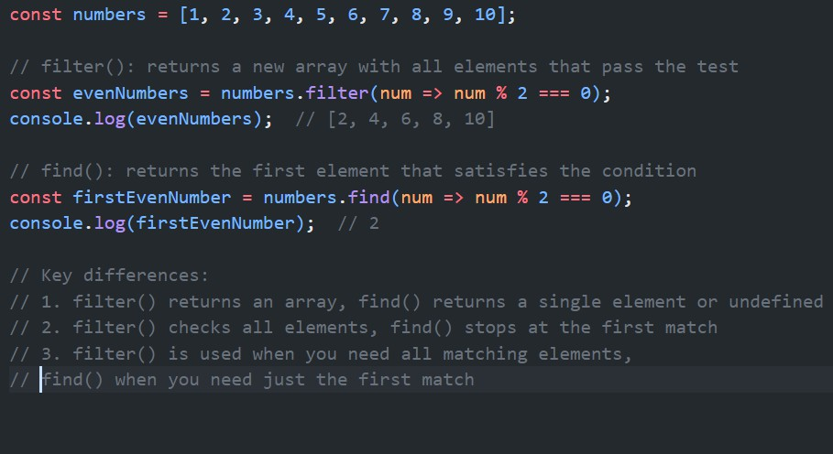
25. Explain the difference between filter() and find() methods.

Slide 31
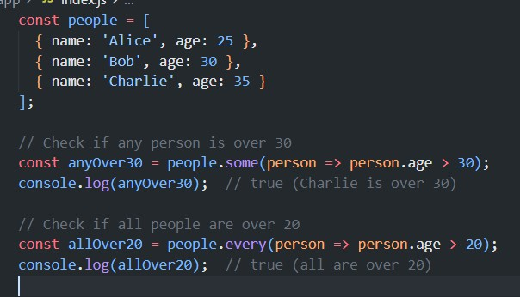
26. Explain the difference between some() and every() methods.
some() method: Returns true if at least one element in the array satisfies the provided testing function. Stops iterating as soon as it finds an element that satisfies the condition. Returns false if no elements satisfy the condition.
every() method: Returns true if all elements in the array satisfy the provided testing function. Stops iterating as soon as it finds an element that doesn't satisfy the
condition.

Slide 32
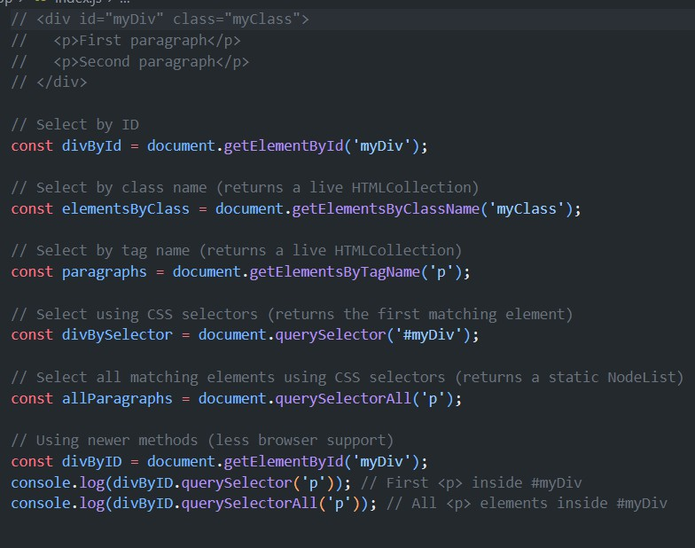
27. How do you select elements in the DOM using JavaScript?

Slide 33
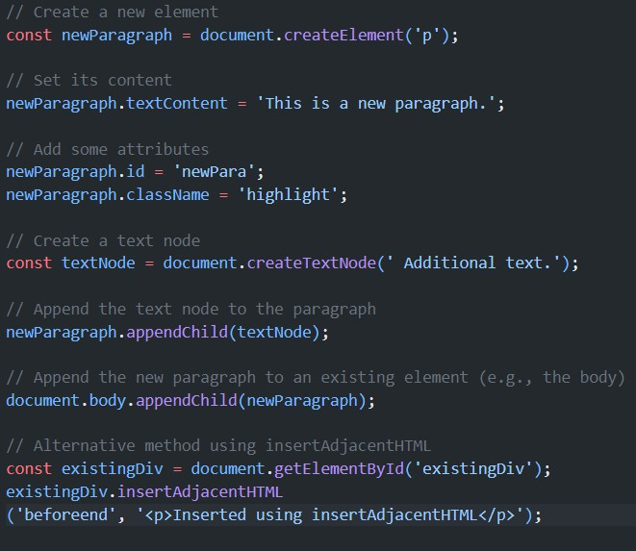
28. How do you create and append elements to the DOM?

Slide 34
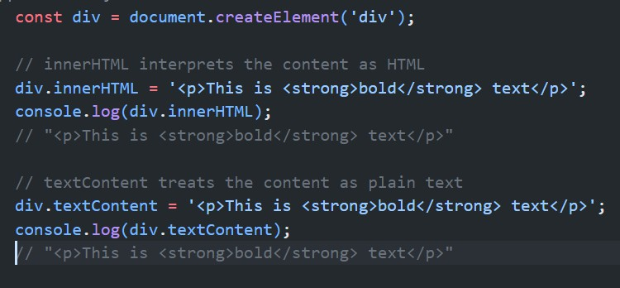
29. Explain the difference between innerHTML and textContent.
Key differences:
innerHTML parses content as HTML, textContent does not
innerHTML can be slower and less secure (risk of XSS attacks)
textContent is generally faster and safer
innerHTML returns all content, including script and style element content
textContent returns the text content of all elements, ignoring tags

Slide 35
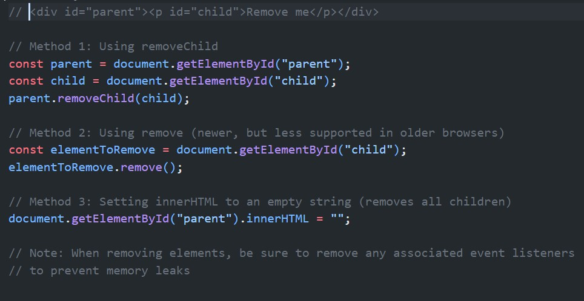
30. How do you remove an element from the DOM?

Slide 36
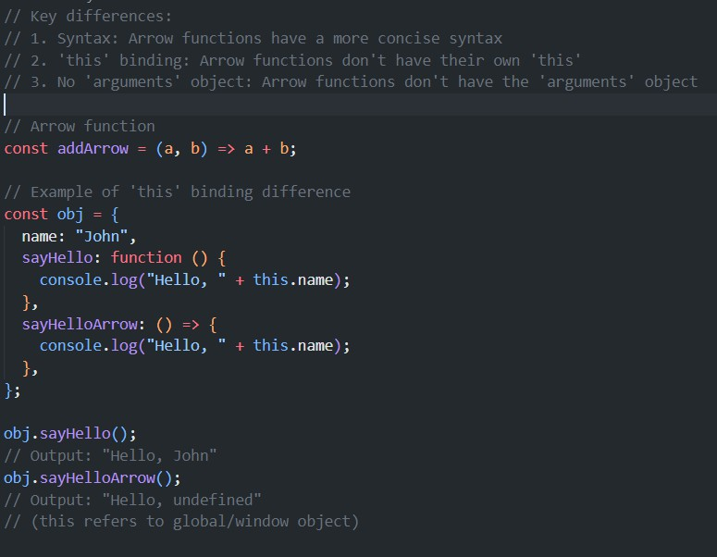
31. What are arrow functions and how do they differ from regular functions?

Slide 37
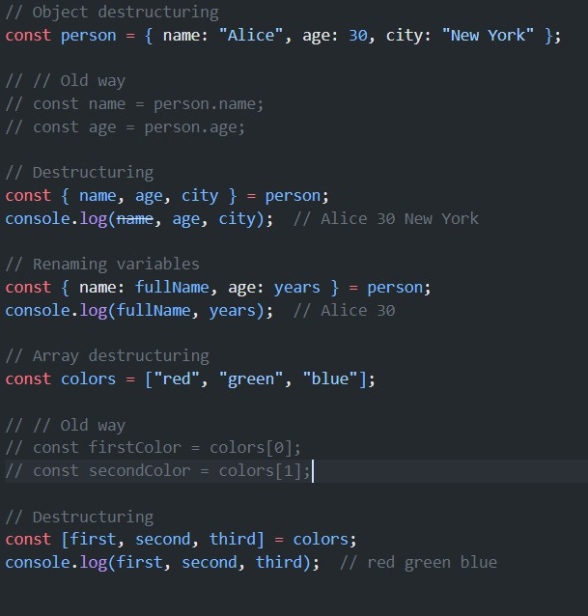
32. Explain the concept of destructuring in JavaScript.
Destructuring is a way to extract multiple values from data stored in objects and arrays.

Slide 38
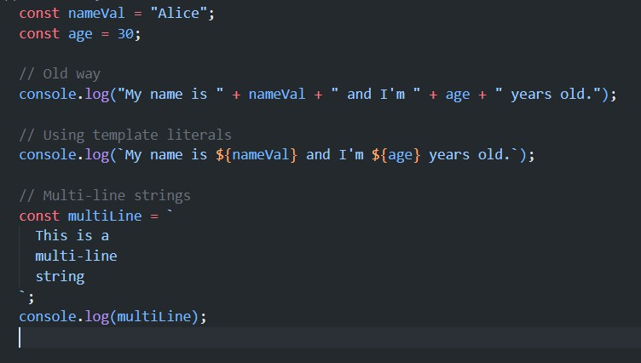
Template literals are string literals that allow embedded expressions and multi-line strings.
33. What are template literals?

Slide 39
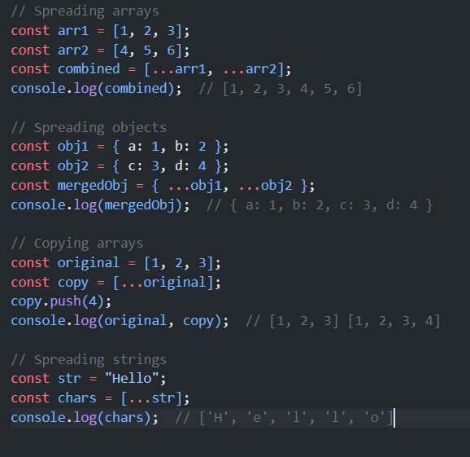
34. What is spread operator, Explain with example?
The spread operator (...) allows an iterable to be expanded in places where zero or more arguments or elements are expected.

Slide 40
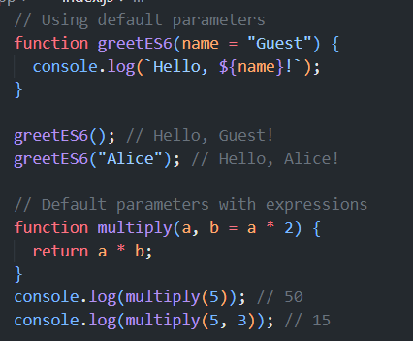
35. What are default parameters in ES6?
Default parameters allow you to set default values for function parameters if no value or undefined is passed.

Slide 41
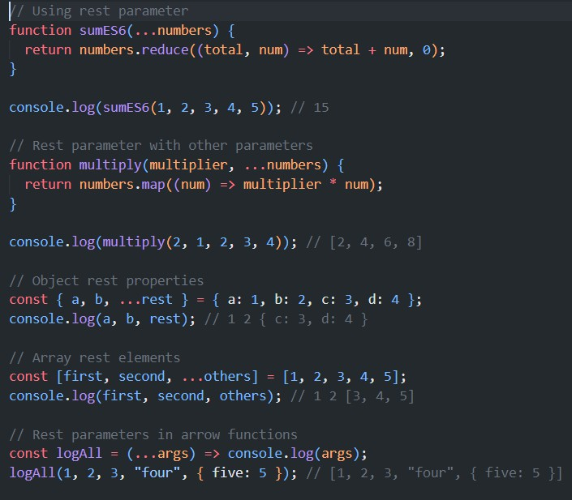
36. How do you use the rest parameter in functions?
The rest parameter syntax allows a function to accept an indefinite number of arguments as an array.

Slide 42
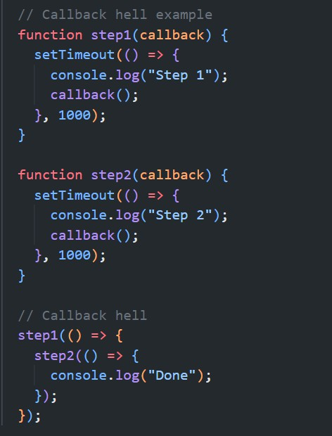
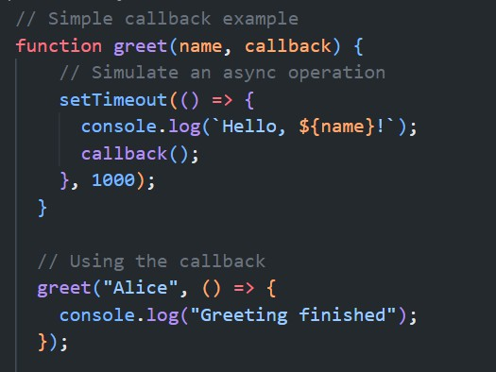
37. What is callback & callback hell explain with example
Callbacks are functions passed as arguments to other functions, often used for asynchronous operations. Callback hell occurs when multiple nested callbacks make code hard to read and maintain.

Slide 43
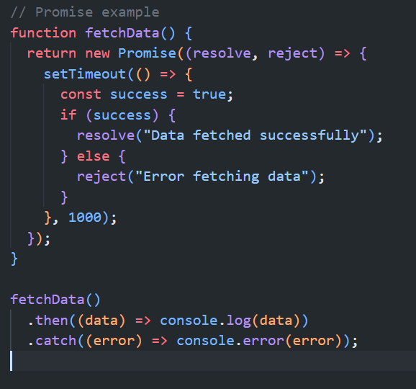
38. What is a Promise in JavaScript with example?
A Promise is an object representing the eventual completion or failure of an asynchronous operation.

Slide 44
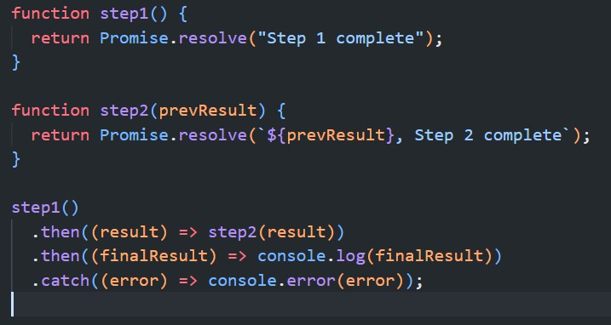
39. How do you chain Promises?
Promise chaining allows you to perform sequential asynchronous operations.

Slide 45
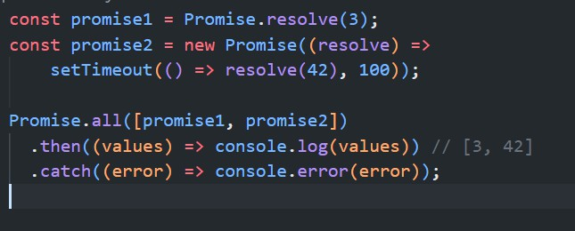
40. What is the purpose of the Promise.all() method?
Promise.all() takes an iterable of promises and returns a single Promise that resolves when all input promises have resolved, or rejects if any input promise rejects.

Slide 46
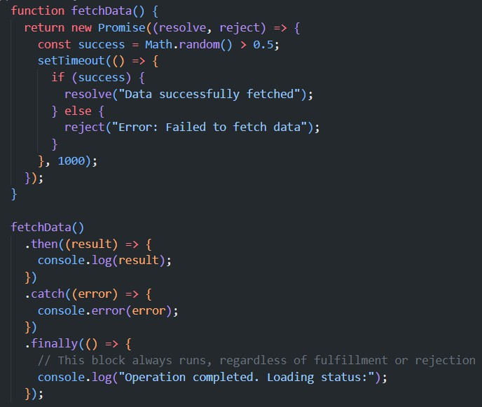
41. What is the purpose of the finally() method in Promises?
The finally() method is used to specify code that should be executed regardless of whether the promise is fulfilled or rejected.

Slide 47
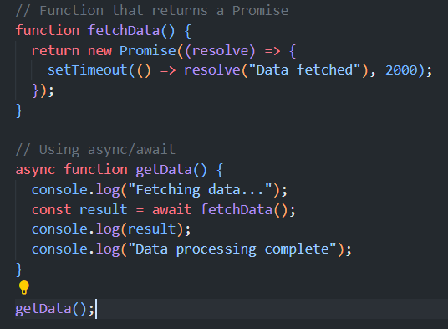
42. What is the purpose of the async await ?
The purpose of async/await is to simplify the syntax for working with Promises, making asynchronous code easier to write and read. It allows you to write asynchronous code that looks and behaves more like synchronous code.

Slide 48
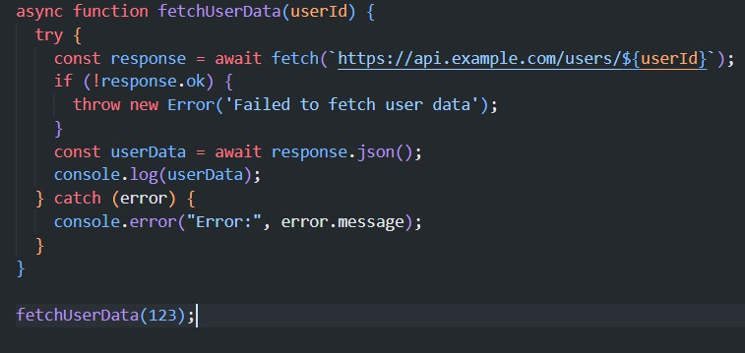
43. How do you handle errors in async/await?

Slide 49
44. What is the difference between async/await and Promises?
Syntax: Async/await provides a more linear, synchronous- looking code structure.
Error handling: Async/await uses try/catch, which is more familiar for synchronous code.
Chaining: Promises use .then() for chaining, while async/await uses regular JavaScript control flow.
Debugging: Async/await can be easier to debug as it behaves more like synchronous code

Slide 50
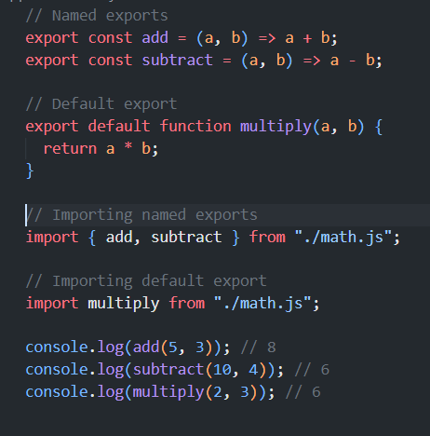
45. What is the difference between default and named exports?
A module can have multiple named exports but only one default export.
Named exports are imported using curly braces, while default exports are imported without them.
Default exports can be imported with any name, while named exports must be imported with their exact names (unless renamed using `as`).

Slide 51
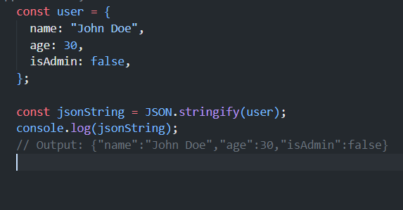
46. How do you convert a JavaScript object to a JSON string?

Slide 52
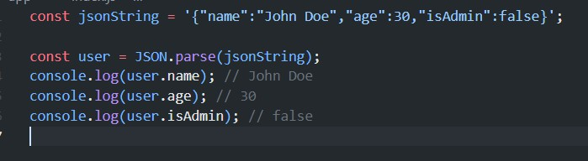
47. How do you parse a JSON string back into a JavaScript object?

Slide 53

48. What is localStorage in JavaScript, and how do you store and retrieve data from it?
localStorage is a web storage object that allows you to store key-value pairs in the browser with no expiration time

Slide 54

49. What is the difference between localStorage and sessionStorage?
Both localStorage and sessionStorage are web storage objects, but they differ in data persistence.
localStorage data persists even after the browser is closed and reopened. sessionStorage data is cleared when the page session ends (i.e., when the tab is closed).
Both have the same API and are limited to storing string data.

Slide 55

50. How do you delete a specific item from localStorage or clear all data from it?

